Slide 1
Machine Learning Fairness
Delayed Impact of Fair Machine Learning by Liu et al.
Fairness Without Demographics in Repeated Loss Minimization by Hashimoto et al.
Yufeng Su
CS598 BL Paper Presentation

Slide 2
Fairness Without Demographics in Repeated Loss Minimization
Hashimoto et al.
ICML 2018 Best Paper Runner Up Awards

Slide 3
Example
Online system (update)
Speech recognition system
standard accent
strange accent

Slide 4
Overview
Problem: Small groups have low representation in average loss
Part I: Focus on the worst group’s loss ignoring time
Part II: Analyze worst case loss over time

Slide 5

Part I
The model:
Representation disparity:
Observed data
Group distribution
Group size
Worst case risk
Group risk

Slide 6

Bounding worst-case risk
How to optimize $R_{max}\left(θ\right)$ if we don’t know the groups?
Upper bound!!!

Slide 7
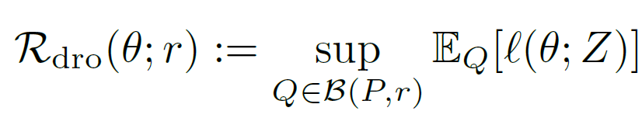






Upper bound
DRO:
If ,
<

Slide 8
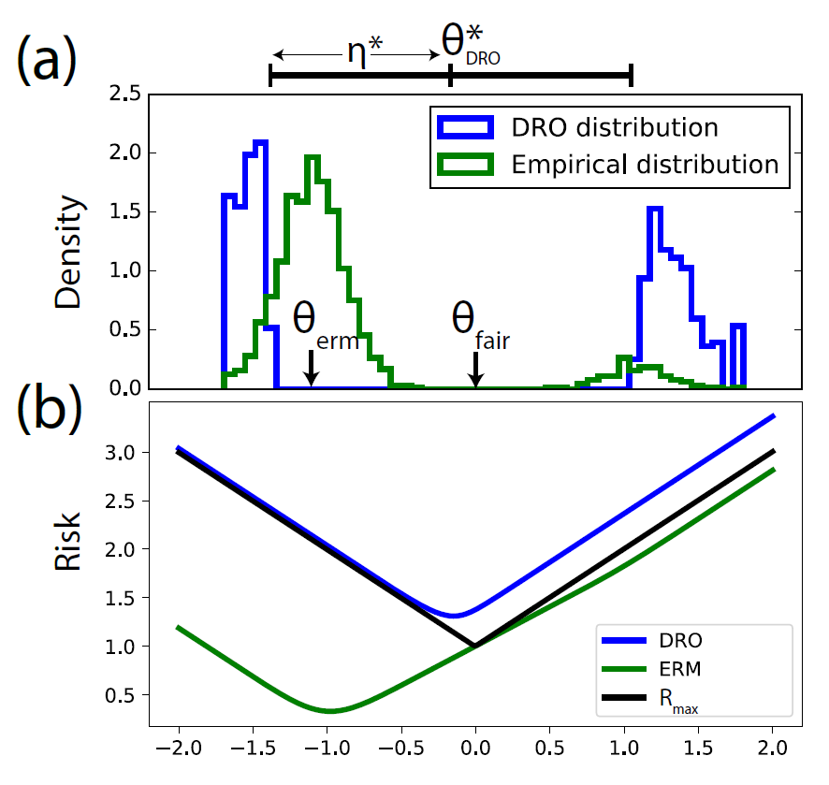
Example behavior of DRO

Slide 9
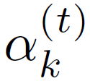
Part II
Is the bound right over time?
Condition: ,

Slide 10





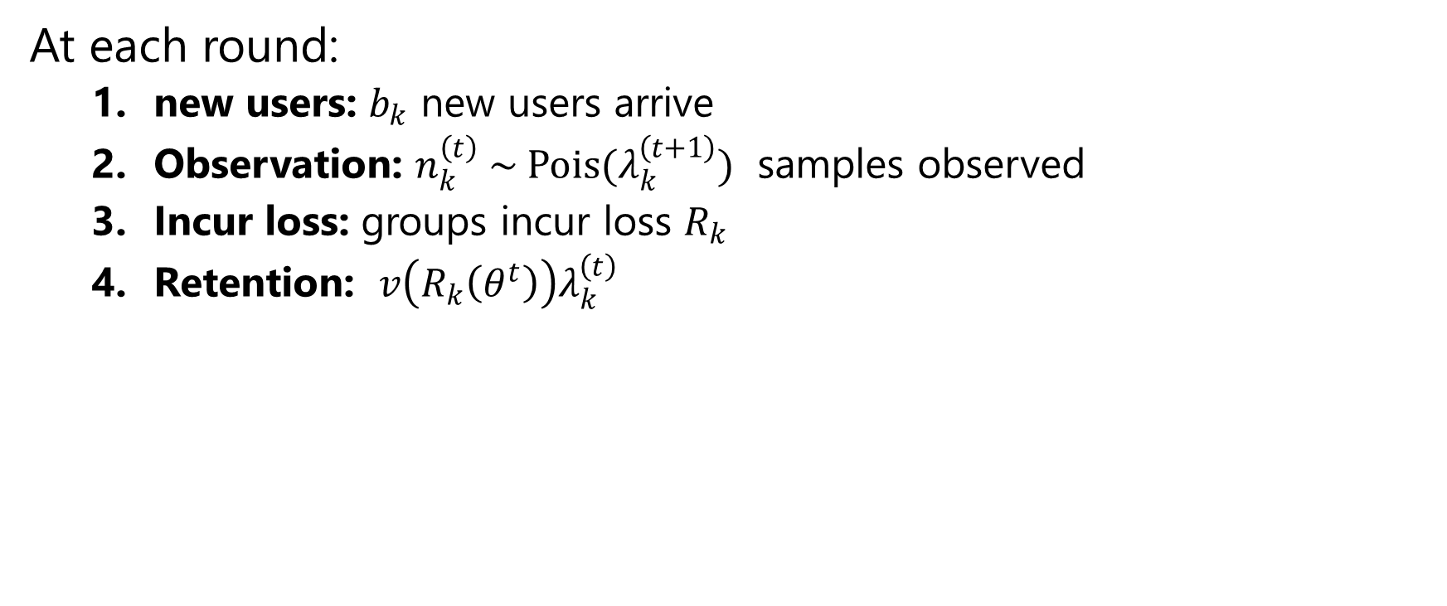
Part II Problem setting
+$b_{k}$
New user
User
Query
*
Loss
At each round:
new users: $b_{k}$ new users arrive
Observation: $n_{k}^{\left(t\right)} \sim Pois{(λ}_{k}^{\left(t+1\right)})$ samples observed
Incur loss: groups incur loss $R_{k}$
Retention: $v\left(R_{k}\left(θ^{t}\right)\right)λ_{k}^{\left(t\right)}$

Slide 11
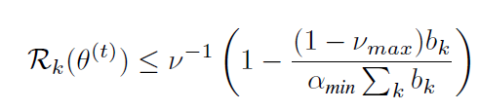

Part II
Is the bound right over time?
Condition: ,
$1. α$ is a lower bound at t = 0
2.

Slide 12

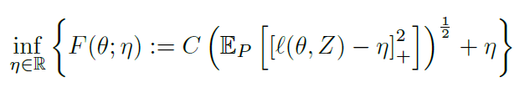

Interpreting the dual
How to optimize ?

Slide 13
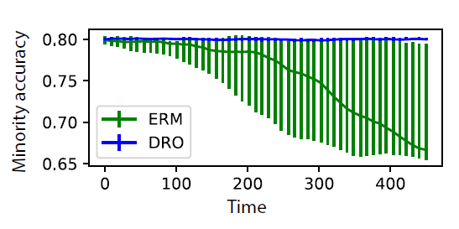
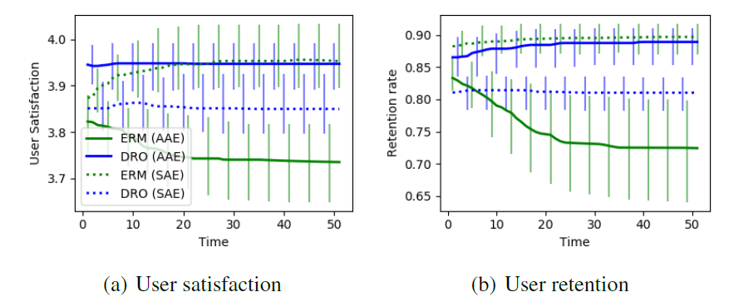
Results

Slide 14
Delayed Impact of Fair Machine Learning
Liu et al.
ICML 2018 Best Paper Award

Slide 15

Banks approving loan based on credit score
Banks want to maximize the utility
Utility
Policy/Model
Caucasian/White
Policy
per Group
Probability Mass
per Group
Credit Score
Group Proportion
African American/Black
All Possible Scores
Utility Function
Utility Function
Profit
if reapy
Loss
if default
Probability of
Repaying

Slide 16

Banks approving loan based on credit score
In a long term, we want to monitor if a ‘social
outcome’, such as credit score, has improved for
different group, especially ones in disadvantage:
Credit Score
Change for Group
Policy
Credit Score Change
given a Score
Score Improvement
if reapy
Score Decrement
if default

Slide 17
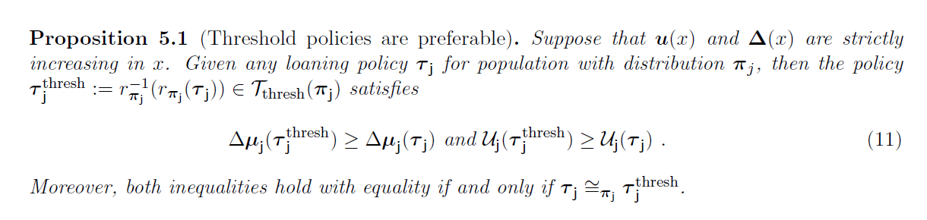
Only analyzing threshold policies?
such that we can analyze policies by their selection rates.

Slide 18
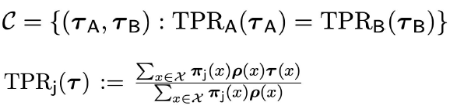
Fairness criteria
Demographic Parity
Equal Opportunity
Selection rates are the same for
both groups.
Selection rate for one group decides
the selection for the other group.

Slide 19
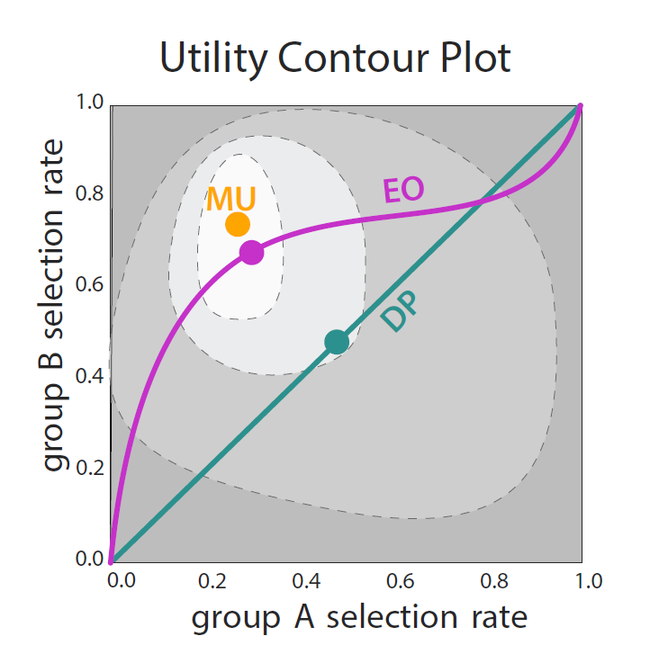
Under different constraints:
MU: Max Utility/No Constraints
DP: Demographic Parity
EO: Equal Opportunity

Slide 20
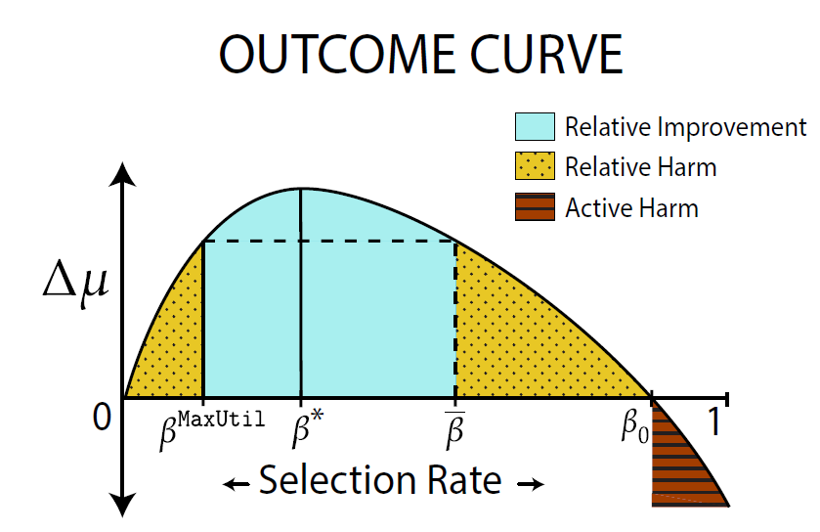

Slide 21
Theoretical result
Fairness Criteria can cause Relative Improvement
DemParity can cause harm by being over-eager
EqOpt can cause harm by being over-eager
EqOpt may avoid active harm where DemParity fails
DemParity never loans less than MaxUtil, but EqOpt might

Slide 22
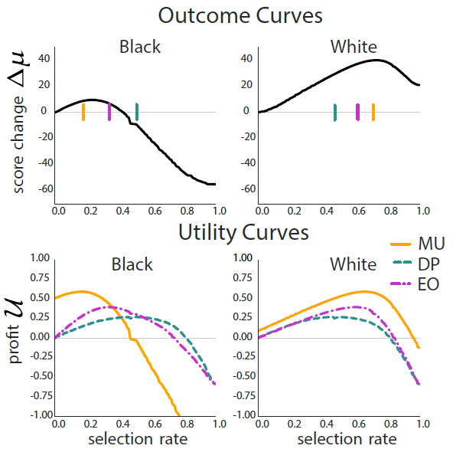
Result
DP is doing actual harm!

